Slide 1
Notes:
in the name of God, Most Gracious, Most Merciful

Slide 2


Electrical Engineers Group
Waleed Abbas (Team Leader)
Mehtab Ahmed
Mohsin Ilyas Faisal Gul Shariq Shakil
Rao Ahtesham Umar
Notes:
The project we are going to implement is a RAG-Based Application for Electrical System Commissioning “Hi, everyone. We are the Electrical Engineers Group, and today, we are excited to present our innovative project: a RAG-Based Application for Electrical System Commissioning. Let me introduce our team: Waleed Abbas, our Team Leader, along with Mehtab Ahmed, Mohsin Ilyas, Faisal Gul, Shariq Shakil, and Rao Ahtesham Umar. Together, we’ve developed a tool designed to streamline and enhance the efficiency of electrical system testing and commissioning processes."

Slide 3
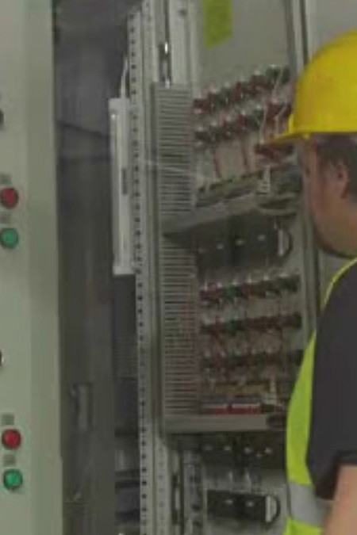
RAG-Based Application for Electrical System Commissioning
Welcome to our presentation on a cutting-edge RAG-based application designed to streamline testing and commissioning processes for electrical transmission systems. This innovative tool combines advanced technologies to enhance efficiency and accuracy in the field.
Notes:
Welcome to our Presentation "To set the stage, our project focuses on a cutting-edge Retrieval-Augmented Generation, or RAG-based, application. This application is specifically designed to address challenges in the commissioning of electrical systems. It leverages advanced AI technologies to improve the efficiency and accuracy of these complex processes. Our goal is to simplify tasks for electrical professionals while ensuring reliability and precision."

Slide 4
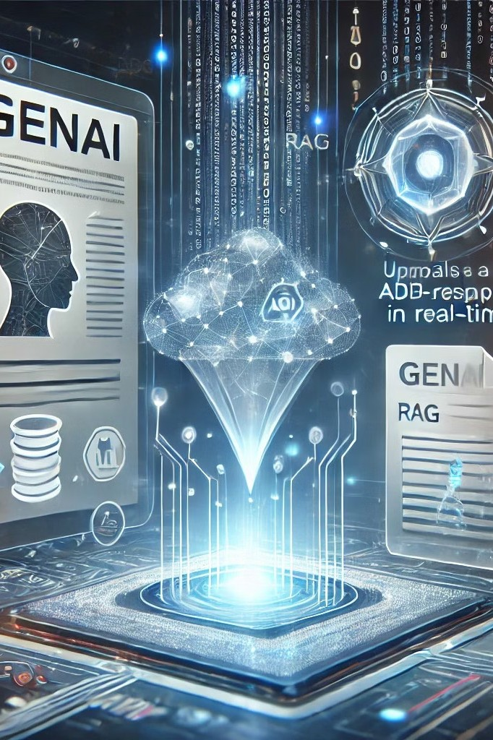
The Challenge: Complex Commissioning Processes
Time-Consuming Manual Processes
Traditional commissioning methods often involve extensive paperwork and manual data analysis, leading to inefficiencies.
Risk of Human Error Complex electrical systems require precise
testing, where manual processes can introduce errors.
Knowledge Accessibility
Accessing specific technical information quickly during commissioning can be challenging.
Notes:
The Challenge
is Complex Commissioning Processes "Let’s start with the key challenges that we aim to resolve.
Time-consuming manual workflows: Traditional commissioning methods often require extensive paperwork and manual data analysis, which can lead to significant inefficiencies.
Risk of human error: The complexity of electrical systems demands precision. However, manual processes can introduce mistakes that may result in costly errors.
Limited accessibility to knowledge: Quickly finding and accessing specific technical information during commissioning can be difficult, adding unnecessary delays. Our project directly addresses these pain points."

Slide 5
Our Solution: RAG-Based Application
Retrieval-Augmented Generation (RAG)
Streamlined Workflow
Real-Time Assistance
Integrates multiple technologies to create a seamless commissioning process.
Offers instant access to relevant information, reducing downtime and errors.
Utilizes advanced AI to provide accurate, context-aware responses to technical queries.
Notes:
Solution
RAG-Based Application "Our solution is a RAG-Based Application that brings three significant improvements:

Slide 6
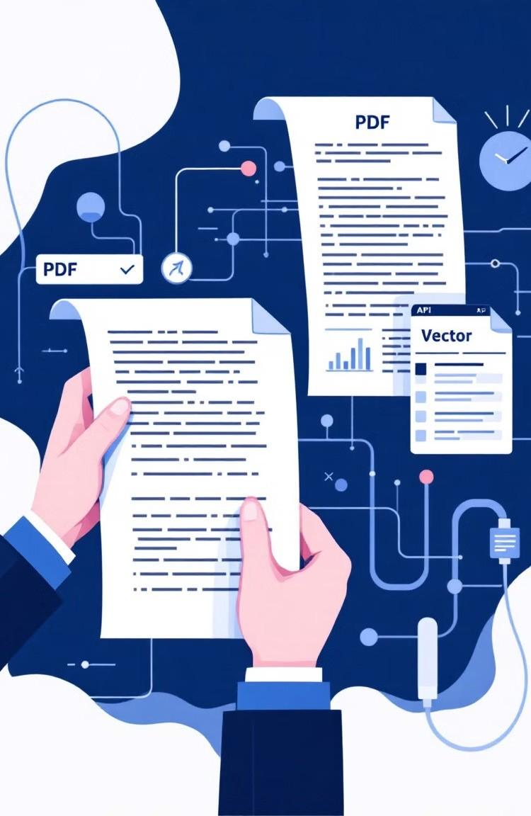
Project Description: Innovative Features
PDF Text Extraction
Efficiently retrieves and processes data from technical documents.
NLP Integration Understands and interprets complex technical language.
Vector Database
Enables rapid similarity searches for relevant information.
Groq API
Powers interactive, query- based responses for user inquiries.
Notes:
Project Feature "Our application is packed with features that revolutionize the way electrical systems are commissioned:
PDF Text Extraction: This allows quick retrieval and processing of data from technical documents. No more manual searching through lengthy files!
NLP Integration: Using Natural Language Processing, the application can understand and interpret complex technical language, ensuring accurate insights.
Vector Database: This enables rapid similarity searches, allowing users to find related information with ease.
Groq API: With this, we deliver interactive, query-based responses tailored to user needs. Together, these features create a powerful tool for electrical professionals."

Slide 7
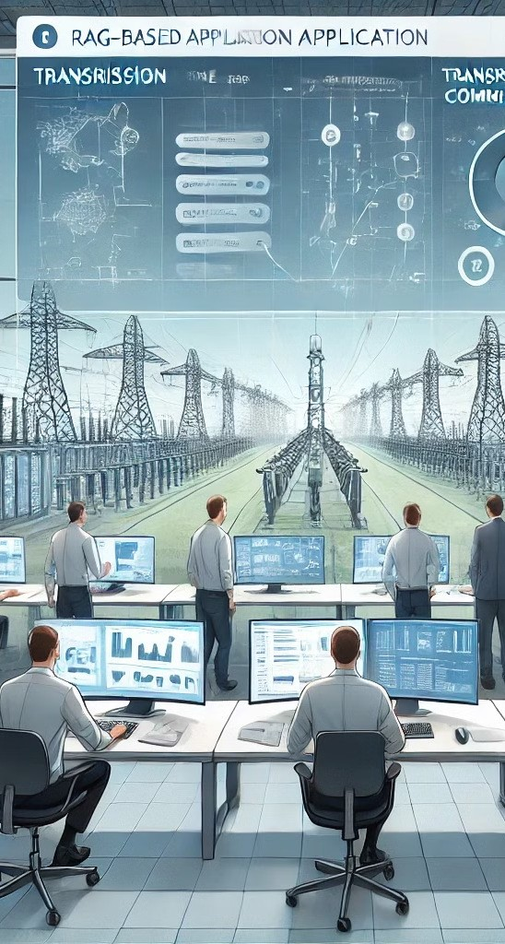
System Architecture Overview
Data Ingestion
PDF documents are extracted and processed from Google Drive.
1
Text Processing
NLP techniques chunk and embed the extracted text.
2
Vector Storage
Processed data is stored in FAISS for efficient retrieval.
3
Query Processing
User queries are matched with stored data using Groq API.
4
Notes:
Here we discuss System Architecture
"Here’s an overview of the system architecture that powers our application:
Data ingestion: PDFs and other documents are uploaded from Google Drive, ensuring all necessary data is in one place.
Text processing: Using NLP techniques, the extracted text is divided into manageable chunks and embedded for analysis.
Vector storage: The processed data is stored in a FAISS vector database, which ensures fast and efficient retrieval.
Query processing: When a user submits a query, it is matched with the stored data using the Groq API to deliver accurate responses. This architecture is robust, scalable, and tailored to meet the needs of complex commissioning scenarios."

Slide 8
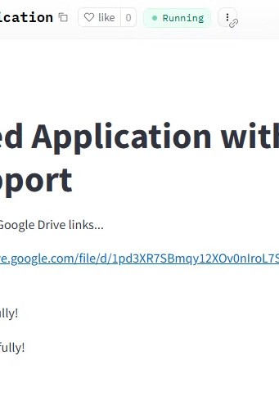
User-Friendly Streamlit Interface
Intuitive Design Clean, user-friendly interface for easy
navigation and interaction.
Real-Time Responses
Instant answers to technical queries during commissioning processes.
Customizable Queries
Flexible input options to address various commissioning scenarios.
Notes:
User-Friendly Streamlit Interface "Our application’s interface is designed to be intuitive and easy to use:
Clean design: The interface is user-friendly, making navigation straightforward for users of all technical levels.
Real-time responses: Users receive instant answers to their technical queries, streamlining the commissioning process.
Customizable queries: The application can handle diverse scenarios by allowing users to input specific requirements. This focus on usability ensures the tool is practical and efficient for professionals in the field."

Slide 9

Comprehensive Tool for Electrical Professionals
1 2 3 4
Data Extraction
Automatically pulls relevant information from complex technical documents.
Processing
Applies NLP to understand context and technical jargon.
Analysis
Provides insights and recommendations based on processed data.
Reporting
Generates comprehensive reports for commissioning documentation.
Notes:
For Electrical Professionals "Our tool is a comprehensive solution for electrical professionals.
It uses NLP to understand context and technical jargon, ensuring accurate interpretation of queries.
The data analysis feature provides actionable insights and recommendations based on processed information.
It generates detailed reports, making documentation more efficient and standardized. With these capabilities, the application significantly enhances the workflow of electrical system commissioning."

Slide 10
Advanced Features: Data Management
PDF Data Extraction
Efficiently retrieves datasets from Google Drive.
1
Chunking and Embedding
Prepares text for efficient processing and analysis.
2
Vector Database (FAISS)
Enables rapid similarity searches for relevant information.
3
Notes:
Its Advanced Data Management "The core technological features include:
Number 1 PDF data extraction: Automatically pulls relevant information from complex technical documents, saving time.
Number 2 Chunking and embedding: Prepares text for efficient processing and analysis, ensuring a smooth workflow.
Number 3 Vector database (FAISS): Enables rapid similarity searches, making it easy to find related technical information. These features are designed to maximize efficiency and accuracy in data handling."

Slide 11
Key Features: Query Handling and User Interface
Groq API Integration
Sophisticated query matching with stored embeddings for accurate responses.
Streamlit Frontend
Interactive, user-friendly interface for real-time interaction and data visualization.
Notes:
The Key Features
Query Handling and Interface
"The application’s key functionalities include:
Groq API integration: This ensures sophisticated query matching with stored embeddings for accurate and context-aware responses.
Streamlit frontend: Provides an interactive and user-friendly interface for real-time interaction and data visualization. These features make the tool both powerful and accessible."

Slide 12

Robust Technological Stack
Streamlit
Powers the interactive frontend for seamless user experience.
pdfplumber
Enables precise PDF data extraction and processing.
sentence-transformers
Generates high-quality text embeddings for analysis.
FAISS
Facebook AI Similarity Search in the vector database.
Notes:
Robust Technological Stack "Our project is built on a strong technological foundation:
Streamlit: Powers the interactive frontend, providing a seamless user experience.
PDF Plumber: Enables precise data extraction from technical documents.
Sentence-transformers: Generates high-quality text embeddings for analysis.
FAISS: Facebook AI Similarity Search ensures rapid and accurate similarity searches. This stack combines cutting-edge tools to deliver a reliable and efficient application."

Slide 13

Notes:
Thank you for your time and attention! We hope this presentation gave you valuable insights into our RAG-based application and its potential to revolutionize the commissioning of electrical systems.
We are excited about the possibilities this tool offers to enhance efficiency, accuracy, and ease for professionals in the field. If you have any questions or feedback, we’d be happy to discuss them now.
Once again, thank you, and we look forward to collaborating to make this innovation a success!"

